Slide 1
CHAPTER 4
EVALUATING A COMPANY’S RESOURCES, CAPABILITIES, AND COMPETITIVENESS

Slide 2
Learn how to assess how well a company’s strategy is working.
Understand why a company’s resources and capabilities are central to its strategic approach and how to evaluate their potential for giving the company a competitive edge over rivals.
Discover how to assess the company’s strengths and weaknesses in light of market opportunities and external threats.
Grasp how a company’s value chain activities can affect the company’s cost structure and customer value proposition.
Understand how a comprehensive evaluation of a company’s competitive situation can assist managers in making critical decisions about their next strategic moves.

Slide 3
EVALUATING A FIRM’S INTERNAL SITUATION
How well is the firm’s present strategy working?
What are the firm’s competitively important resources and capabilities?
Is the firm able to take advantage of market opportunities and overcome external threats to its external well-being?
Are the firm’s prices and costs competitive with those of key rivals, and does it have an appealing customer value proposition?
Is the firm competitively stronger or weaker than key rivals?
What strategic issues and problems merit front-burner managerial attention?
4–3

Slide 4
QUESTION 1: HOW WELL IS THE FIRM’S PRESENT STRATEGY WORKING?
Best indicators of a well-conceived, well-executed strategy:
The firm is achieving its stated financial and strategic objectives.
The firm is an above-average industry performer.
4–4

Slide 5
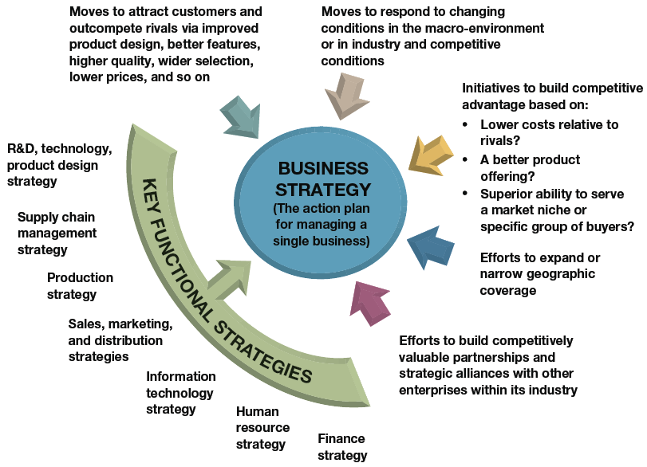
FIGURE 4.1
Identifying the Components of a Single-Business Company’s Strategy
4–5

Slide 6
SPECIFIC INDICATORS OF STRATEGIC SUCCESS
Growth in firm’s sales and market share
Acquisition and retention of customers
Strengthening image and reputation with customers
Increasing profit margins, net profits and ROI
Growing financial strength and credit rating
Leadership in factors relevant to market\industry success
Continuing improvement in key measures of operating performance
4–6

Slide 7
Sluggish financial performance and second-rate market accomplishments almost always signal weak strategy, weak execution, or both.
4–7

Slide 8
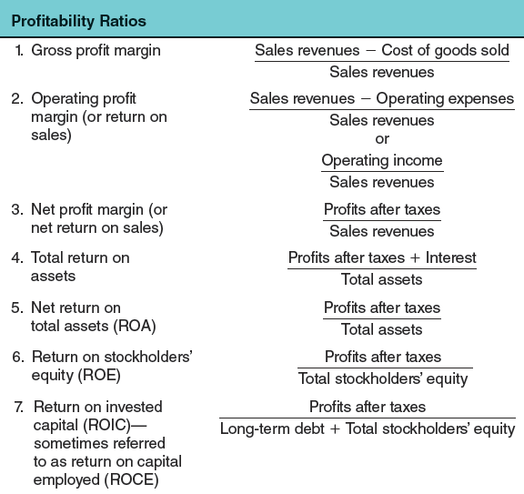
TABLE 4.1
Key Financial Ratios
4–8

Slide 9
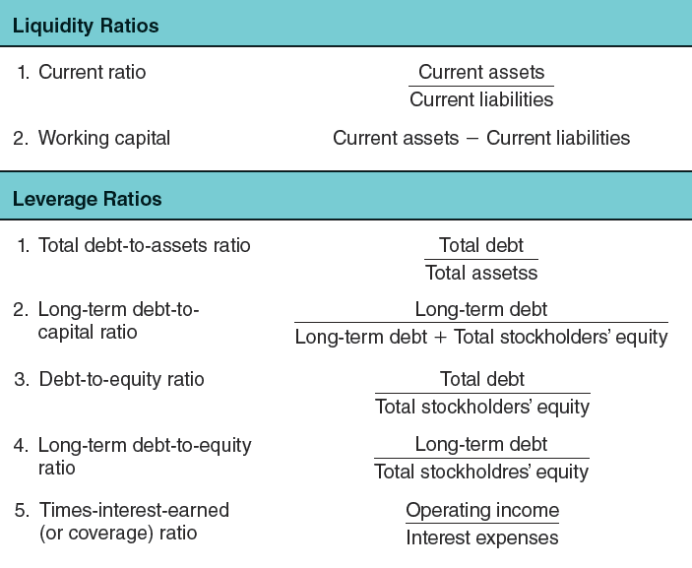
TABLE 4.1
Key Financial Ratios
4–9

Slide 10
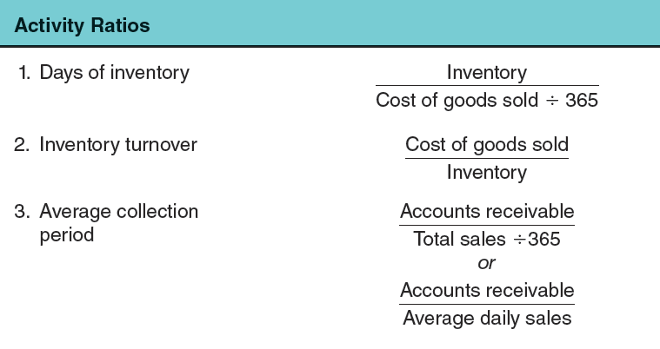
TABLE 4.1
Key Financial Ratios
4–10

Slide 11
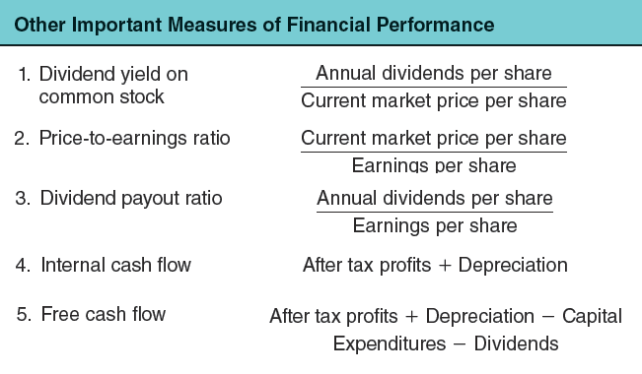
TABLE 4.1
Key Financial Ratios
4–11

Slide 12
QUESTION 2: WHAT ARE THE FIRM’S COMPETITIVELY IMPORTANT RESOURCES AND CAPABILITIES?
Competitive Assets
Are the firm’s resources and capabilities.
Are the determinants of its competitiveness and ability to succeed in the marketplace.
Are what a firm’s strategy depends on to develop sustainable competitive advantage over its rivals.
4–12

Slide 13
A resource is a competitive asset that is owned or controlled by a firm
A capability or competence is the capacity of a firm to perform and internal activity competently through deployment of a firm’s resources.
A firm’s resources and capabilities represent its competitive assets and are big determinants of its competitiveness and ability to succeed in the marketplace.
4–13

Slide 14
IDENTIFYING THE COMPANY’S RESOURCES AND CAPABILITIES
A Resource
Is a productive input or competitive asset that is owned or controlled by a firm (e.g., a fleet of oil tankers).
A Capability
Is the capacity of a firm to perform some activity proficiently (e.g., superior skills in marketing).
4–14

Slide 15
Resource and capability analysis is a powerful tool for sizing up a company’s competitive assets and determining if they can support a sustainable competitive advantage over market rivals.
4–15

Slide 16
TABLE 4.2
Types of Company Resources
Tangible Resources
Physical resources
Financial resources
Technological assets
Organizational resources
Intangible Resources
Human assets and intellectual capital
Brands, company image, and reputational assets
Relationships: alliances, joint ventures, or partnerships
Company culture and incentive system
4–16

Slide 17
IDENTIFYING CAPABILITIES
An Organizational Capability
Is the intangible but observable capacity of a firm to perform a critical activity proficiently using a related combination (cross-functional bundle) of its resources.
Is knowledge-based, residing in people and in a firm’s intellectual capital or in its organizational processes and functional systems, which embody tacit knowledge.
4–17

Slide 18
A resource bundle is a linked and closely integrated set of competitive assets centered around one or more cross-functional capabilities.
The VRIN tests for sustainable competitive advantage ask if a resource is Valuable, Rare, Inimitable, and Non-substitutable.
4–18

Slide 19
VRIN TESTING: RESOURCES AND CAPABILITIES
Identifying the firm’s resources and capabilities by testing the competitive power of its resources and capabilities:
Is the resource (or capability) competitively Valuable?
Is the resource Rare—is it something rivals lack?
Is the resource hard to copy (Inimitable)?
Is the resource invulnerable to the threat of substitution from different types of resources and capabilities (Non-substitutable)?
4–19

Slide 20
Social complexity (company culture, interpersonal relationships among managers or R&D teams, trust-based relations with customers or suppliers) and causal ambiguity are two factors that inhibit the ability of rivals to imitate a firm’s most valuable resources and capabilities.
Causal ambiguity makes it very hard to figure out how a complex resource contributes to competitive advantage and therefore exactly what to imitate.
4–20

Slide 21
A company requires a dynamically evolving portfolio of resources and capabilities to sustain its competitiveness and help drive improvements in its performance.
4–21

Slide 22
A dynamic capability is the ongoing capacity of a firm to modify its existing resources and capabilities or create new ones by:
Improving existing resources and capabilities incrementally
Adding new resources and capabilities to the firm’s competitive asset portfolio
4–22

Slide 23
MANAGING RESOURCES AND CAPABILITIES DYNAMICALLY
Threats to Resources and Capabilities:
Rivals providing better substitutes over time
Capabilities decaying from benign neglect
Disruptive competitive environment change
Managing Capabilities Dynamically
Attending to the ongoing modification of existing competitive assets.
Taking advantage of any opportunities to develop totally new kinds of capabilities.
4–23

Slide 24
QUESTION 3: IS THE COMPANY ABLE TO SEIZE MARKET OPPORTUNITIES AND NULLIFY EXTERNAL THREATS?
SWOT Analysis
Is a powerful tool for sizing up a firm’s:
Internal strengths (the basis for strategy)
Internal weaknesses (deficient capabilities)
Market opportunities (strategic objectives)
External threats (strategic defenses)
4–24

Slide 25
SWOT analysis is a simple but powerful tool for sizing up a company’s strengths and weaknesses, its market opportunities, and the external threats to its future well-being.
4–25

Slide 26
Basing a company’s strategy on its most competitively valuable strengths gives the company its best chance for market success.
4–26

Slide 27
IDENTIFYING A COMPANY’S INTERNAL STRENGTHS
A Competence
Is an activity that a firm has learned to perform with proficiency—a capability.
A Core Competence
Is a proficiently performed internal activity that is central to a firm’s strategy and competitiveness.
A Distinctive Competence
Is a competitively valuable activity that a firm performs better than its rivals.
4–27

Slide 28
A competence is an activity that a firm has learned to perform with proficiency—a capability, in other words.
A core competence is an activity that a firm performs proficiently that is also central to its strategy and competitive success.
A distinctive competence is a competitively important activity that a firm performs better than its rivals—it thus represents a competitively superior internal strength.
4–28

Slide 29
IDENTIFYING A FIRM’S WEAKNESSES AND COMPETITIVE DEFICIENCIES
A Weakness (Competitive Deficiency)
Is something a firm lacks or does poorly (in comparison to others) or a condition that puts it at a competitive disadvantage in the marketplace.
Types of Weaknesses:
Inferior skills, expertise, or intellectual capital
Deficiencies in physical, organizational, or intangible assets
Missing or competitively inferior capabilities in key areas
4–29

Slide 30
A firm’s strengths represent its competitive assets.
A firm’s weaknesses are shortcomings that constitute competitive liabilities.
4–30

Slide 31
IDENTIFYING A COMPANY’S MARKET OPPORTUNITIES
Characteristics of Market Opportunities:
An absolute “must pursue” market
Represents much potential but is hidden in “fog of the future.”
A marginally interesting market
Presents high risk and questionable profit potential.
An unsuitable\mismatched market
Is best avoided as the firm’s strengths are not matched to market factors.
4–31

Slide 32
A company is well advised to pass on a particular market opportunity unless it has or can acquire the competencies needed to capture it.
4–32

Slide 33
IDENTIFYING THE THREATS TO A FIRM’S FUTURE PROFITABILITY
Types of Threats:
Normal course-of-business threats
Sudden-death (survival) threats
Considering Threats:
Identify the threats to the firm’s future prospects.
Evaluate what strategic actions can be taken to neutralize or lessen their impact.
4–33

Slide 34
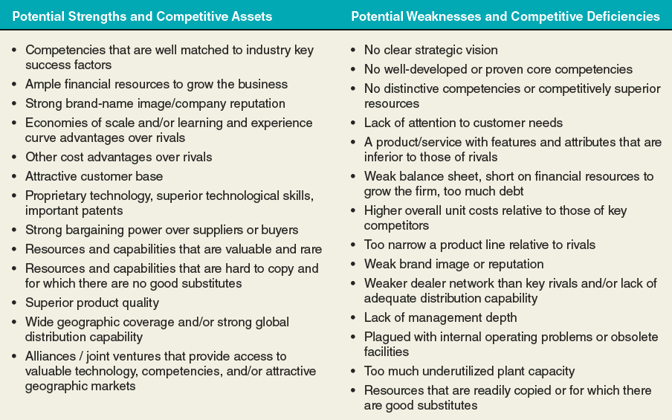
TABLE 4.3
What to Look for in Identifying a Firm’s Strengths, Weaknesses, Opportunities, and Threats
4–34

Slide 35
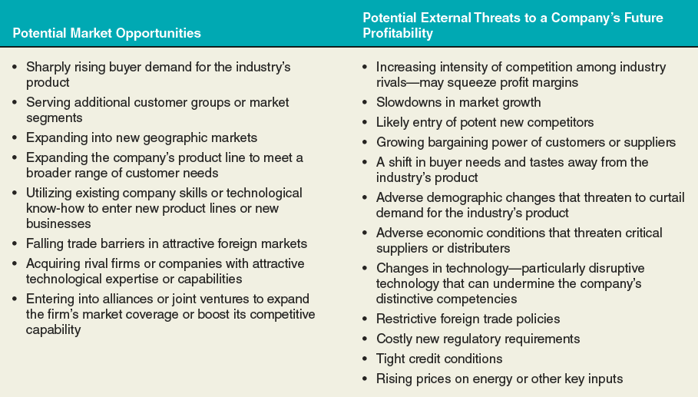
TABLE 4.3
What to Look for in Identifying a Firm’s Strengths, Weaknesses, Opportunities, and Threats (cont’d)
4–35

Slide 36
Simply making lists of a company’s strengths, weaknesses, opportunities, and threats is not enough; the payoff from SWOT analysis comes from the conclusions about a company’s situation and the implications for strategy improvement that flow from the four lists.
4–36

Slide 37
WHAT DO SWOT LISTINGS REVEAL?
SWOT Analysis Involves:
Drawing conclusions from the SWOT listings about the firm’s overall situation.
Translating these conclusions into strategic actions by the firm that:
Match its strategy to its internal strengths and to market opportunities.
Correct important weaknesses and defend it against external threats.
4–37

Slide 38
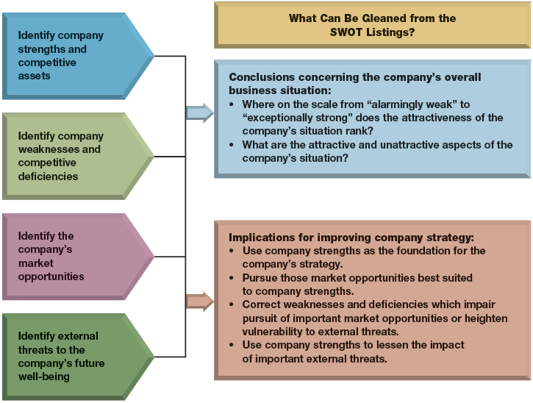
FIGURE 4.2
The Steps Involved in SWOT Analysis: Identify the Four Components of SWOT, Draw Conclusions, Translate Implications into Strategic Actions
4–38

Slide 39
USING SWOT ANALYSIS
What are the attractive aspects of the firm’s situation?
What aspects are of the most concern?
Are the firm’s internal strengths and competitive assets sufficiently strong to enable it to compete successfully?
Are the firm’s weaknesses and competitive deficiencies correctable, or could they be fatal if not remedied soon?
Do the firm’s strengths outweigh its weaknesses by an attractive margin?
Does the firm have attractive market opportunities that are well suited to its internal strengths?
Does the firm lack the competitive assets (internal strengths) to pursue the most attractive opportunities?
Where on a scale of 1 to 10 (1 = weak and 10 = strong) do the firm’s overall situation and future prospects rank?
4–39

Slide 40
QUESTION 4: ARE THE COMPANY’S COST STRUCTURE AND CUSTOMER VALUE PROPOSITION COMPETITIVE?
Signs of A Firm’s Competitive Strength:
Its prices and costs are in line with rivals.
Its customer-value proposition is competitive and cost effective.
Its bundled capabilities are yielding a sustainable competitive advantage.
4–40

Slide 41
The higher a company’s costs are above those of close rivals, the more competitively vulnerable it becomes.
Conversely, the greater the amount of customer value that a company can offer profitably relative to close rivals, the less competitively vulnerable it becomes.
4–41

Slide 42
THE CONCEPT OF A COMPANY VALUE CHAIN
The Value Chain
Identifies the primary internal activities that create and deliver customer value and the requisite related support activities.
Permits a deep look at the firm’s cost structure and ability to offer low prices.
Reveals the emphasis that a firm places on activities that enhance differentiation and support higher prices.
4–42

Slide 43
A company’s value chain identifies the primary activities and related support activities that create customer value.
4–43

Slide 44
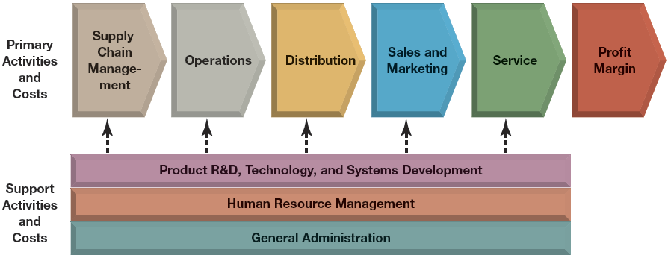
FIGURE 4.3
A Representative Company Value Chain
4–44

Slide 45
COMPARING THE VALUE CHAINS OF RIVAL FIRMS
Value Chain Analysis
Facilitates a comparison, activity-by-activity, of how effectively and efficiently a firm delivers value to its customers, relative to its competitors.
The Value Chain Analysis Process:
Segregate the firm’s operations into different types of primary and secondary activities to identify the major components of its internal cost structure.
Use activity-based costing to evaluate the activities.
Do the same for significant competitors.
4–45

Slide 46
A company’s cost competitiveness depends not only on the costs of internally performed activities (its own value chain) but also on costs in the value chains of its suppliers and distribution channel allies.
4–46

Slide 47
VALUE CHAIN SYSTEM FOR AN ENTIRE INDUSTRY
Industry Value Chain:
The firm’s internal value chain
The value chains of industry suppliers
The value chains of channel intermediaries
Effects of the Industry Value Chain:
Costs and margins of suppliers and channel partners can affect prices to end consumers.
Activities of channel partners can affect industry sales volumes and customer satisfaction.
4–47

Slide 48
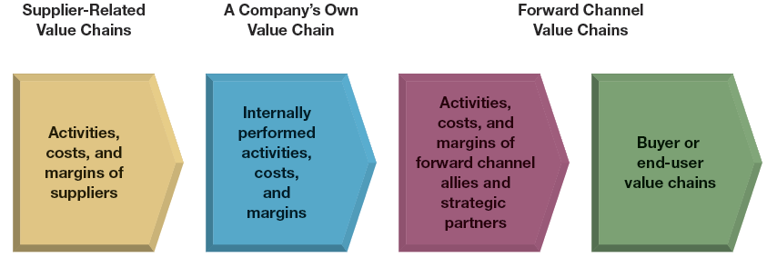
FIGURE 4.4
A Representative Value Chain System
4–48

Slide 49
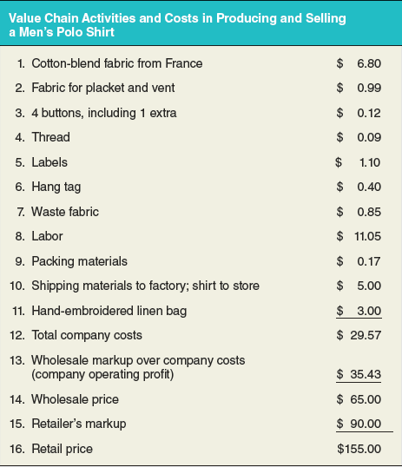
ILLUSTRATION CAPSULE 4.1
The Value Chain for KP MacLane,
a producer of Polo Shirts
4–49

Slide 50
ILLUSTRATION CAPSULE 4.1
The Value Chain for KP MacLane,
a producer of Polo Shirts
Which activities in the value chain are primary activities? Which are secondary activities?
Which activities are linked to the value chain for the entire industry?
How could activity cost(s) could be reduced without harming the competitive strength of KP MacLane?
4–50

Slide 51
A company’s cost competitiveness depends not only on the costs of internally performed activities (its own value chain) but also on costs in the value chains of its suppliers and distribution channel allies.
4–51

Slide 52
Benchmarking is a potent tool for improving a company’s own internal activities that is based on learning how other companies perform them and borrowing their “best practices.”
4–52

Slide 53
BENCHMARKING AND VALUE CHAIN ACTIVITIES
Benchmarking:
Involves improving a firm’s internal activities based on learning other companies’ “best practices.”
Assesses whether the cost competitiveness and effectiveness of a firm’s value chain activities are in line with its competitors’ activities.
Sources of Benchmarking Information
Reports, trade groups, analysts and customers
Visits to benchmark companies
Data from consulting firms
4–53

Slide 54
Benchmarking the costs of company activities against rivals provides hard evidence of whether a company is cost-competitive.
4–54

Slide 55
ILLUSTRATION CAPSULE 4.2
Benchmarking and Ethical Conduct
Avoid discussions or actions that could lead to or imply an interest in restraint of trade, market and/or customer allocation schemes, price fixing, dealing arrangements, bid rigging, or bribery. Don’t discuss costs with competitors if costs are an element of pricing.
Refrain from the acquisition of trade secrets from another by any means that could be interpreted as improper, including the breach of any duty to maintain secrecy. Do not disclose or use any trade secret that may have been obtained through improper means or that was disclosed by another in violation of duty to maintain its secrecy or limit its use.
Be willing to provide to your benchmarking partner the same type and level of information that you request from that partner.
Communicate fully and early in the relationship to clarify expectations, avoid misunderstanding, and establish mutual interest in the benchmarking exchange.
Be honest and complete with the information submitted.
The use or communication of a benchmarking partner’s name with the data obtained or practices observed requires the prior permission of the benchmarking partner.
Honor the wishes of benchmarking partners regarding how the information that is provided will be handled and used.
In benchmarking with competitors, establish specific ground rules up-front. For example, “We don’t want to talk about things that will give either of us a competitive advantage, but rather we want to see where we both can mutually improve or gain benefit.”
Check with legal counsel if any information-gathering procedure is in doubt. If uncomfortable, do not proceed. Alternatively, negotiate and sign a specific nondisclosure agreement that will satisfy the attorneys representing each partner.
4–55

Slide 56
STRATEGIC OPTIONS FOR REMEDYING A COST OR VALUE DISADVANTAGE
Places in the total value chain system for a firm to look for ways to improve its efficiency and effectiveness:
The firm’s own internal activity segments
The suppliers’ part of the overall value chain system
The forward channel portion of the value chain system.
4–56

Slide 57
IMPROVING INTERNALLY PERFORMED VALUE CHAIN ACTIVITIES
Implement best practices throughout the firm, particularly for high-cost activities.
Eliminate some cost-producing activities altogether by revamping the value chain.
Relocate high-cost activities to areas where they can be performed more cheaply.
Outsource activities that can be performed by vendors or contractors more cheaply than if done in-house.
Invest in productivity enhancing, cost-saving technological improvements.
Find ways to detour around activities or items where costs are high.
Redesign products and/or components to facilitate speedier and more economical manufacture or assembly.
4–57

Slide 58
IMPROVING THE EFFECTIVENESS OF THE CUSTOMER VALUE PROPOSITION AND ENHANCING DIFFERENTIATION
Implement best practices for quality for high-value activities.
Adopt best practices and technologies that spur innovation, improve design, and enhance creativity.
Implement the best practices in providing customer service.
Reallocate resources to activities having the most impact on value for the customer and their most important purchase criteria.
For intermediate buyers, gain an understanding of how the activities the firm performs impact the buyer’s value chain.
Adopt best practices for marketing, brand management, and enhancing customer perceptions.
4–58

Slide 59
IMPROVING SUPPLIER-RELATED VALUE CHAIN ACTIVITIES
Pressure suppliers for lower prices.
Switch to lower-priced substitute inputs.
Collaborate closely with suppliers to identify mutual cost-saving opportunities.
Work with suppliers to enhance the firm’s differentiation.
Select and retain suppliers who meet higher-quality standards.
Coordinate with suppliers to enhance design or other features desired by customers.
Provide incentives to suppliers to meet higher-quality standards, and assist suppliers in their efforts to improve.
4–59

Slide 60
IMPROVING VALUE CHAIN ACTIVITIES OF FORWARD CHANNEL ALLIES
Achieving Cost-Based Competitiveness:
Pressure forward channel allies to reduce their costs and markups so as to make the final price to buyers more competitive.
Collaborate with forward channel allies to identify win-win opportunities to reduce costs.
Change to a more economical distribution strategy, including switching to cheaper distribution channels.
4–60

Slide 61
ENHANCING DIFFERENTIATION THROUGH ACTIVITIES AT THE FORWARD END OF THE VALUE CHAIN SYSTEM
Enhancing Differentiation:
Engage in cooperative advertising and promotions with forward channel allies.
Use exclusive arrangements with downstream sellers or other mechanisms that increase their incentives to enhance delivered customer value.
Create and enforce standards for downstream activities and assist in training channel partners in business practices.
4–61

Slide 62
Performing value chain activities with capabilities that permit the company to either outmatch rivals on differentiation or beat them on costs will give the company a competitive advantage.
4–62

Slide 63
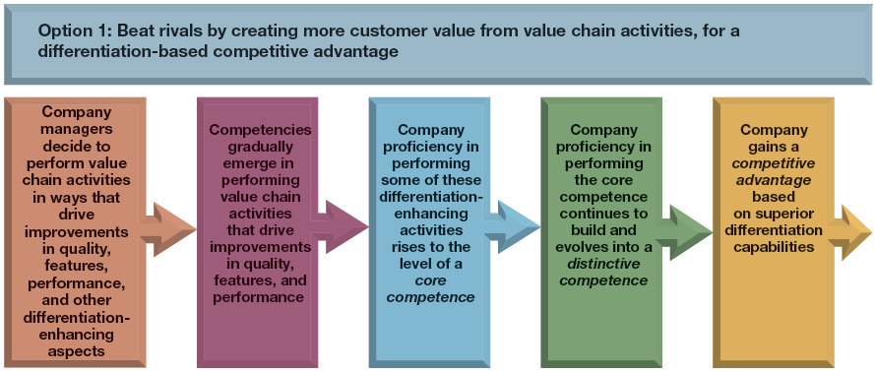
FIGURE 4.5
Translating Company Performance of Value Chain Activities into Competitive Advantage
4–63

Slide 64
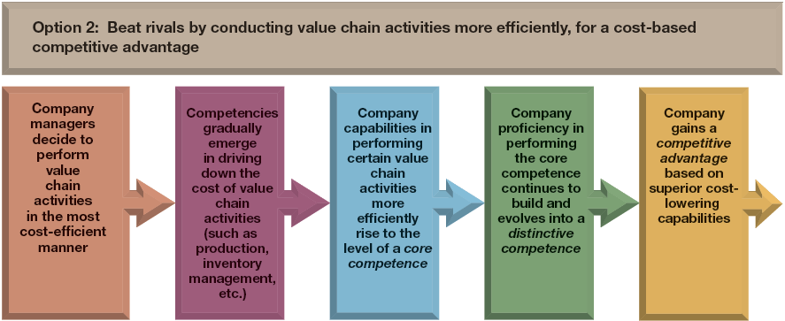
FIGURE 4.5
Translating Company Performance of Value Chain Activities into Competitive Advantage (cont’d)
4–64

Slide 65
QUESTION 5: IS THE FIRM COMPETITIVELY STRONGER OR WEAKER THAN KEY RIVALS?
Assessing the firm’s overall competitive strength:
How does the firm rank relative to competitors on each of the important factors that determine market success?
Does the firm have a net competitive advantage or disadvantage versus major competitors?
4–65

Slide 66
High-weighted competitive strength ratings signal a strong competitive position and possession of competitive advantage; low ratings signal a weak position and competitive disadvantage.
4–66

Slide 67
THE COMPETITIVE STRENGTH ASSESSMENT PROCESS
Step 1
Make a list of the industry’s key success factors and measures of competitive strength or weakness (6 to 10 measures usually suffice).
Step 2
Assign a weight to each competitive strength measure based on its perceived importance.
Step 3
Rate the firm and its rivals on each competitive strength measure and multiply by each measure by its corresponding weight.
4–67

Slide 68
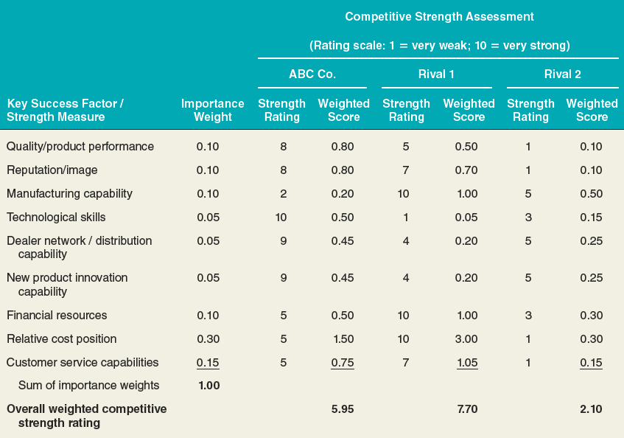
TABLE 4.4
A Representative Weighted Competitive Strength Assessment
4–68

Slide 69
A company’s competitive strength scores pinpoint its strengths and weaknesses against rivals and point directly to the kinds of offensive/defensive actions it can use to exploit its competitive strengths and reduce its competitive vulnerabilities.
4–69

Slide 70
STRATEGIC IMPLICATIONS OF COMPETITIVE STRENGTH ASSESSMENT
The higher a firm’s overall weighted strength rating, the stronger its overall competitiveness versus rivals.
The rating score indicates the total net competitive advantage for a firm relative to other firms.
Firms with high competitive strength scores are targets for benchmarking.
The ratings show how a firm compares against rivals, factor by factor (or capability by capability).
Strength scores can be useful in deciding what strategic moves to make.
4–70

Slide 71
A good strategy must contain ways to deal with all the strategic issues and obstacles that stand in the way of the company’s financial and competitive success in the years ahead.
4–71

Slide 72
QUESTION 6: WHAT STRATEGIC ISSUES AND PROBLEMS MERIT FRONT-BURNER MANAGERIAL ATTENTION?
Strategic “How To” Issues:
How to meet challenges of new foreign competitors.
How to combat the price discounting of rivals.
How to both reduce high costs and prepare for price reductions.
How to sustain growth as buyer demand slows.
How to adapt to the changing demographics of the firm’s customer base.
4–72

Slide 73
QUESTION 6: WHAT STRATEGIC ISSUES AND PROBLEMS MERIT FRONT-BURNER MANAGERIAL ATTENTION?
Strategic “Should We” Issues:
Expand rapidly or cautiously into foreign markets.
Reposition the firm to move to a different strategic group.
Counter increasing buyer interest in substitute products.
Expand of the firm’s product line.
Correct the firm’s competitive deficiencies by acquiring a rival firm with the missing strengths.
4–73

Slide 74
Zeroing in on the strategic issues a company faces and compiling a list of problems and roadblocks creates a strategic agenda of problems that merit prompt managerial attention.
4–74

