Slide 1
CHAPTER 3
EVALUATING A COMPANY’S EXTERNAL ENVIRONMENT

Slide 2
Become aware of factors in a company’s broad macro-environment that may have strategic significance.
Gain command of the basic concepts and analytical tools widely used to diagnose the competitive conditions in a company’s industry.
Become adept at mapping the market positions of key groups of industry rivals.
Learn how to use multiple frameworks to determine whether an industry’s outlook presents a company with sufficiently attractive opportunities for growth and profitability.

Slide 3
FIGURE 3.1
From Thinking Strategically about the Company’s Situation to Choosing a Strategy
Chapter 3
Thinking
strategically
about a firm’s
external
environment
Form a
strategic
vision of
where the
firm needs to head
Identify
promising
strategic
options
for the firm
Select the
best strategy
and business
model for the firm
Thinking
strategically
about a firm’s
internal
environment
Chapter 4
3–3

Slide 4
The macro-environment encompasses the broad environmental context in which a company’s industry is situated that includes strategically relevant components over which the firm has no direct control.
3–4

Slide 5
PESTEL analysis focuses on the six principal components of strategic significance in the macro-environment:
Political
Economic,
Social
Technological,
Environmental
Legal
3–5

Slide 6
QUESTION 1: WHAT ARE THE STRATEGICALLY RELEVANT FACTORS IN THE MACRO-ENVIRONMENT?
PESTEL Analysis
Focuses on principal components of strategic significance in the macro-environment:
Political factors
Economic conditions (local to worldwide)
Sociocultural forces
Technological factors
Environmental factors (the natural environment)
Legal/regulatory conditions
3–6

Slide 7
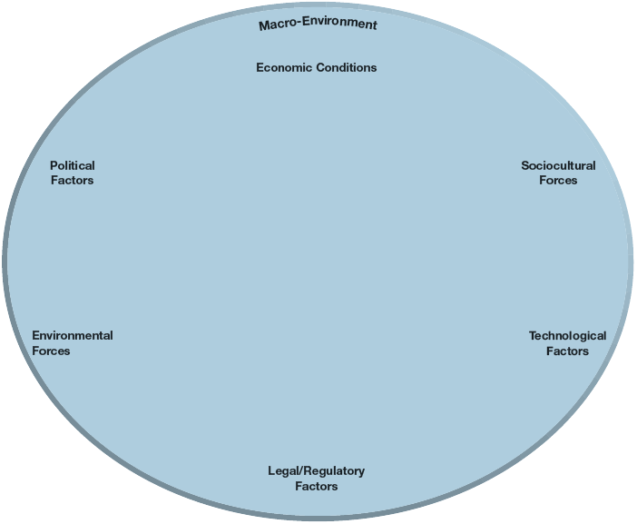
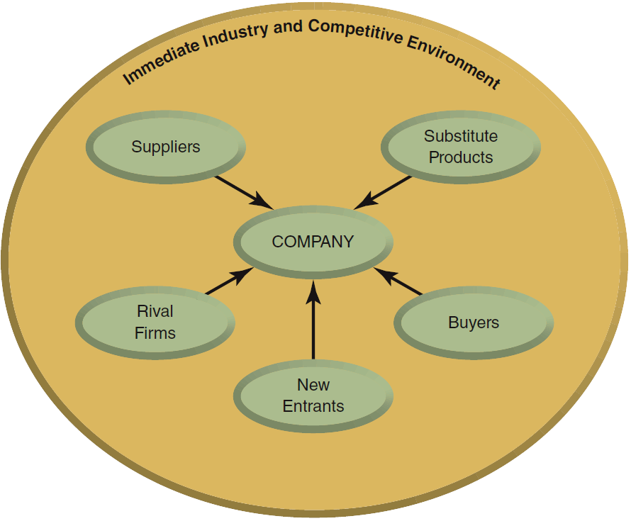
FIGURE 3.2
The Components of a Company’s Macro-Environment
3–7

Slide 8
TABLE 3.1
The Six Components of the Macro-Environment
Component | Description
Political factors | These factors include political policies and processes, including the extent to which a government intervenes in the economy. They include such matters as tax policy, fiscal policy, tariffs, the political climate, and the strength of institutions such as the federal banking system. Some political factors, such as bailouts, are industry-specific. Others, such as energy policy, affect certain types of industries (energy producers and heavy users of energy) more than others.
Economic conditions | Economic conditions include the general economic climate and specific factors such as interest rates, exchange rates, the inflation rate, and the unemployment rate, the rate of economic growth, trade deficits or surpluses, savings rates, and per capita domestic product. Economic factors also include conditions in the markets for stocks and bonds, which can affect consumer confidence and discretionary income. Some industries, such as construction, are particularly vulnerable to economic downturns but are positively affected by factors such as low interest rates. Others, such as discount retailing, may benefit when general economic conditions weaken, as consumers become more price-conscious.
Sociocultural forces | Sociocultural forces include the societal values, attitudes, cultural factors, and lifestyles that impact businesses, as well as demographic factors such as the population size, growth rate and age distribution. Sociocultural forces vary by locale and change over time. An example is the trend toward healthier lifestyles, which can shift spending toward exercise equipment and health clubs and away from alcohol and snack foods. Population demographics can have large implications for industries such as health care, where costs and service needs vary with demographic factors such as age and income distribution.
3–8

Slide 9
TABLE 3.1
The Six Components of the Macro-Environment (cont’d)
Component | Description
Technological factors | Technological factors include the pace of technological change and technical developments that have the potential for wide-ranging effects on society, such as genetic engineering and nanotechnology. They include institutions involved in creating new knowledge and controlling the use of technology, such as R&D consortia, university-sponsored technology incubators, patent and copyright laws, and government control over the Internet. Technological change can encourage the birth of new industries, such as those based on nanotechnology, and disrupt others, such as the recording industry.
Environmental forces | This includes ecological and environmental forces such as weather, climate, climate change, and associated factors like water shortages. These factors can directly impact industries such as insurance, farming, energy production, and tourism. They may have an indirect but substantial effect on other industries such as transportation and utilities.
Legal and regulatory factors | These factors include the regulations and laws with which companies must comply such as consumer laws, labor laws, antitrust laws, and occupational health and safety regulation. Some factors, such as banking deregulation, are industry-specific. Others, such as minimum wage legislation, affect certain types of industries (low-wage, labor-intensive industries) more than others.
3–9

Slide 10
THINKING STRATEGICALLY ABOUT A COMPANY’S INDUSTRY AND COMPETITIVE ENVIRONMENT
How strong are the industry’s competitive forces?
What are the driving forces in the industry, and what impact will they have on competitive intensity and industry profitability?
What market positions do industry rivals occupy—who is strongly positioned and who is not?
What strategic moves are rivals likely to make next?
What are the industry’s key success factors?
Is the industry outlook conducive to good profitability?
3–10

Slide 11
QUESTION 2: HOW STRONG ARE THE INDUSTRY’S COMPETITIVE FORCES?
The Five Competitive Forces:
Competition from rival sellers
Competition from potential new entrants
Competition from producers of substitute products
Supplier bargaining power
Customer bargaining power
3–11

Slide 12
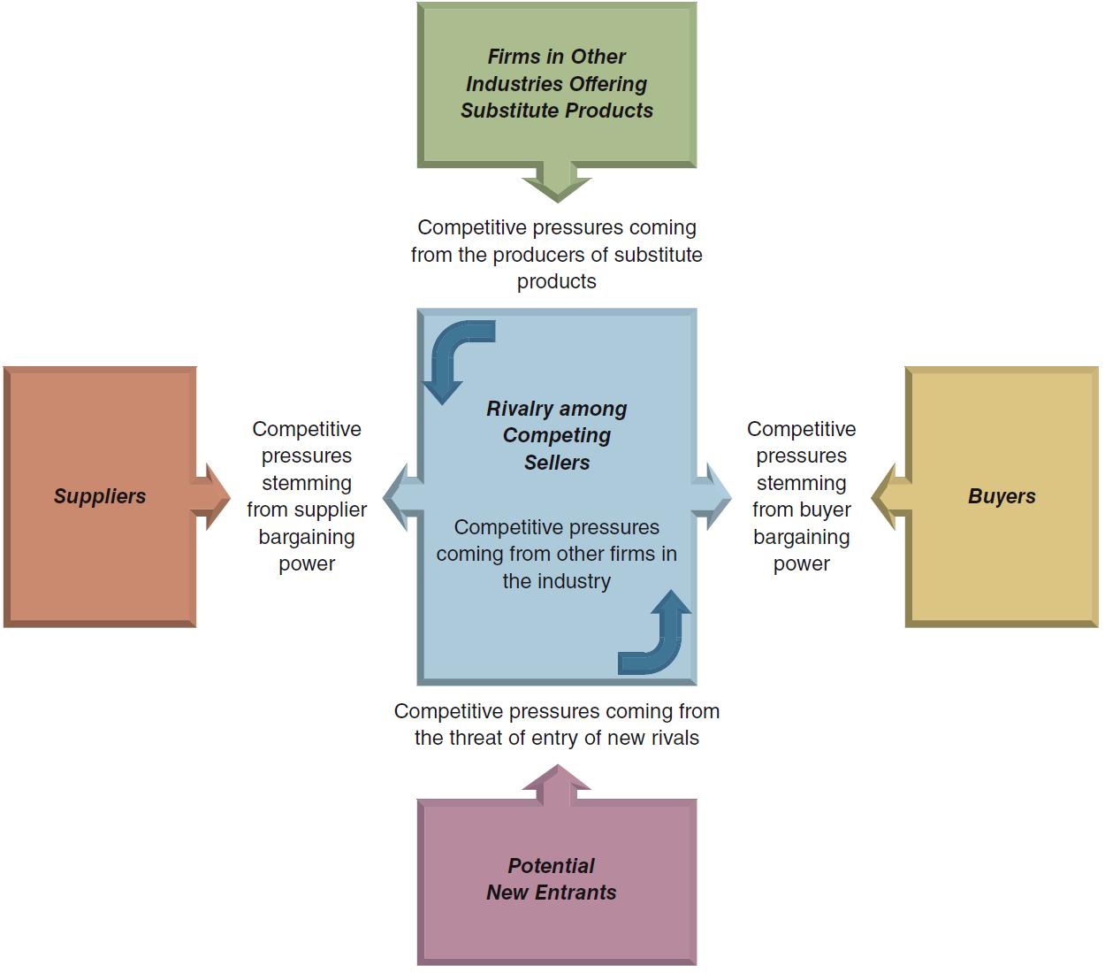
FIGURE 3.3
The Five-Forces Model of Competition: A Key Analytical Tool
3–12

Slide 13
USING THE FIVE-FORCES MODEL OF COMPETITION
Step 1
For each of the five forces, identify the different parties involved, and the specific factors that bring about competitive pressures.
Step 2
Evaluate how strong the pressures stemming from each of the five forces are (strong, moderate, or weak).
Step 3
Determine whether the collective strength of all five competitive forces is conducive to earning attractive profits in the industry.
3–13

Slide 14
COMPETITIVE PRESSURES THAT INCREASE RIVALRY AMONG COMPETING SELLERS
Buyer demand is growing slowly or declining.
It is becoming less costly for buyers to switch brands.
Industry products are becoming less differentiated.
There is unused production capacity, and\or products have high fixed costs or high storage costs.
The number of competitors is increasing and\or they are becoming more equal in size and competitive strength.
The diversity of competitors is increasing.
High exit barriers keep firms from exiting the industry.
3–14

Slide 15
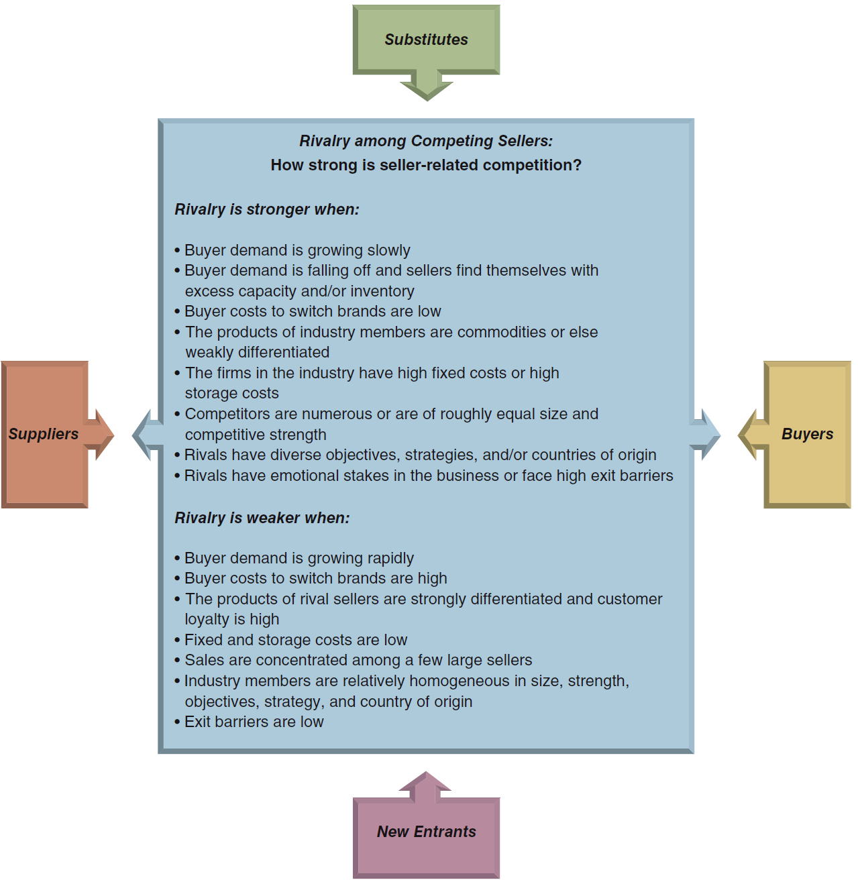
FIGURE 3.4
Factors Affecting the Strength of Rivalry
3–15

Slide 16
TABLE 3.2
Common “Weapons” for Competing with Rivals
Competitive Weapons | Primary Effects
Price discounting, clearance sales | Lowers price (P), acts to boost total sales volume and market share, lowers profit margins per unit sold when price cuts are big and/or increases in sales volume are relatively small
Couponing, advertising items on sale | Acts to increase unit sales volume and total revenues, lowers price (P), increases unit costs (C), may lower profit margins per unit sold (P – C)
Advertising product or service characteristics, using ads to enhance a company’s image | Boosts buyer demand, increases product differentiation and perceived value (V), acts to increase total sales volume and market share, may increase unit costs (C) and/or lower profit margins per unit sold
Innovating to improve product performance and quality | Acts to increase product differentiation and value (V), boosts buyer demand, acts to boost total sales volume, likely to increase unit costs (C)
Introducing new or improved features, increasing the number of styles or models to provide greater product selection | Acts to increase product differentiation and value (V), strengthens buyer demand, acts to boost total sales volume and market share, likely to increase unit costs (C)
Increasing customization of product or service | Acts to increase product differentiation and value (V), increases switching costs, acts to boost total sales volume, often increases unit costs (C)
Building a bigger, better dealer network | Broadens access to buyers, acts to boost total sales volume and market share, may increase unit costs (C)
Improving warranties, offering low-interest financing | Acts to increase product differentiation and value (V), increases unit costs (C), increases buyer costs to switch brands, acts to boost total sales volume and market share
3–16

Slide 17
COMPETITIVE PRESSURES ASSOCIATED WITH THE THREAT OF NEW ENTRANTS
Entry Threat Considerations:
Expected defensive reactions of incumbent firms
Strength of barriers to entry
Attractiveness of a particular market’s growth in demand and profit potential
Capabilities and resources of potential entrants
Entry of existing competitors into market segments in which they have no current presence
3–17

Slide 18
MARKET ENTRY BARRIERS FACING NEW ENTRANTS
Incumbent cost advantages related to learning and experience, proprietary patents and technology, favorable locations, and lower fixed costs
Strong brand preferences and customer loyalty
Strong “network effects” in customer demand
High capital requirements
Building a network of distributors or dealers and securing adequate space on retailers’ shelves
Restrictive government policies
3–18

Slide 19
Whether an industry’s entry barriers ought to be considered high or low depends on the resources and capabilities possessed by the pool of potential entrants.
High entry barriers and weak entry threats today do not always translate into high entry barriers and weak entry threats tomorrow.
3–19

Slide 20
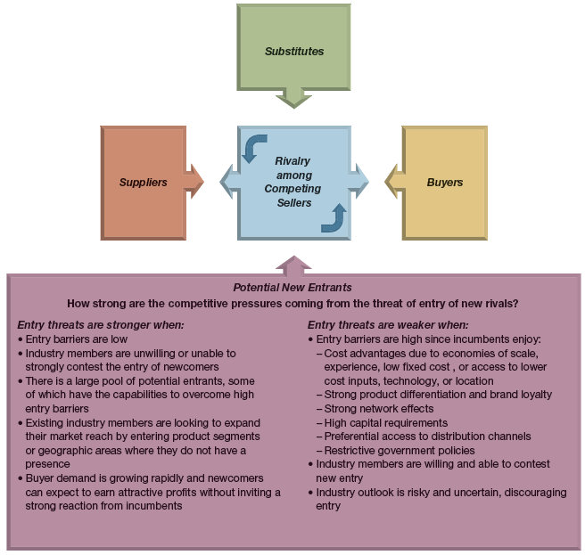
FIGURE 3.5
Factors Affecting the Threat of Entry
3–20

Slide 21
COMPETITIVE PRESSURES FROM THE SELLERS OF SUBSTITUTE PRODUCTS
Substitute Products Considerations:
Readily available and attractively priced?
Comparable or better in terms of quality, performance, and other relevant attributes?
Offer lower switching costs to buyers?
Indicators of Substitutes’ Competitive Strength:
Increasing rate of growth in sales of substitutes
Substitute producers adding new output capacity
Increasing profitability of substitute producers
3–21

Slide 22
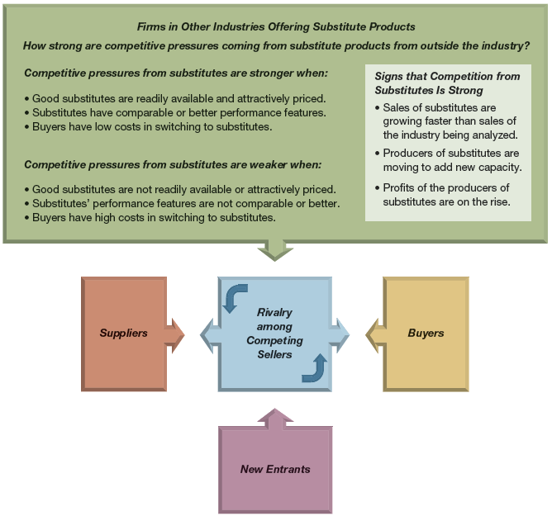
FIGURE 3.6
Factors Affecting Competition from Substitute Products
3–22

Slide 23
COMPETITIVE PRESSURES STEMMING FROM SUPPLIER BARGAINING POWER
Supplier Bargaining Power Depends On:
Strength of demand for and availability of suppliers’ products.
Whether suppliers provide a differentiated input that enhances the performance of the industry’s product.
Industry members’ costs for switching among suppliers
Size of suppliers relative to size of industry members
Fraction of the cost of the supplier’s product relative to the total cost of the industry’s product
Number of suppliers relative to the number of industry members
Possibility of backward integration into suppliers’ industry
Availability of good substitutes for suppliers’ products
Whether industry members are major customers of suppliers.
3–23

Slide 24
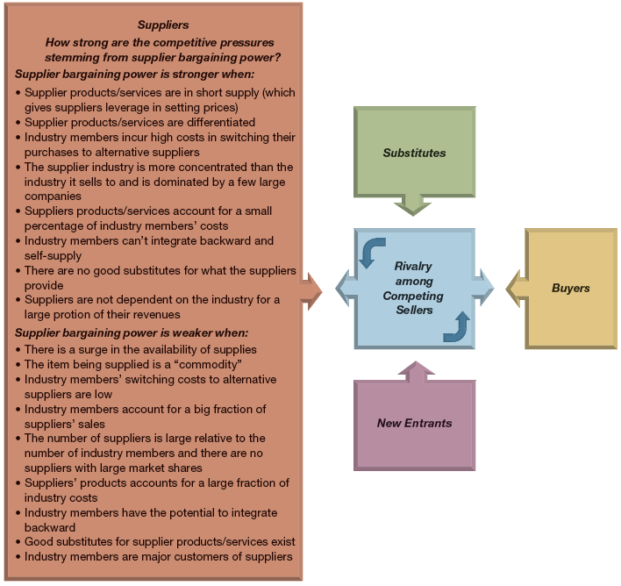
FIGURE 3.7
Factors Affecting the Bargaining Power of Suppliers
3–24

Slide 25
COMPETITIVE PRESSURES STEMMING FROM BUYER BARGAINING POWER AND PRICE SENSITIVITY
Buyer Bargaining Power Considerations:
Strength of buyers’ demand for sellers’ products
Degree to which industry goods are differentiated
Buyers’ costs for switching to competing sellers or substitutes
Number and size of buyers relative to number of sellers
Buyers’ knowledge of products, costs and pricing
Threat of buyers’ integration into sellers’ industry
Buyers’ discretion in delaying purchases
Buyers’ price sensitivity due to low profits, size of purchase, and consequences of purchase
3–25

Slide 26
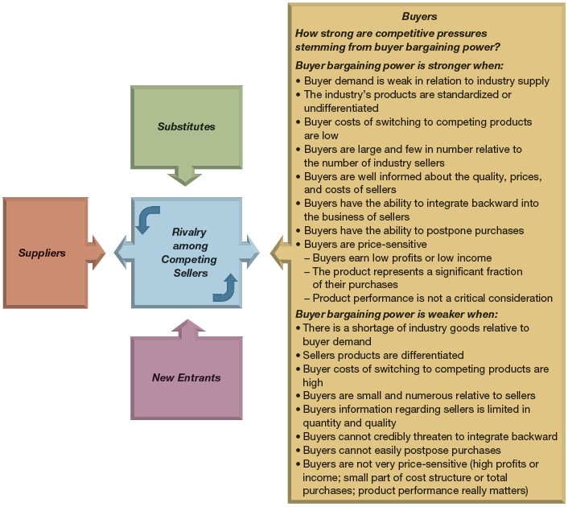
FIGURE 3.8
Factors Affecting the Bargaining Power of Buyers
3–26

Slide 27
IS THE COLLECTIVE STRENGTH OF THE FIVE COMPETITIVE FORCES CONDUCIVE TO GOOD PROFITABILITY?
Is the state of competition in the industry stronger than “normal”?
Can industry firms expect to earn decent profits given prevailing competitive forces?
Are some of the competitive forces sufficiently powerful to undermine industry profitability?
Even one powerful force may be enough to make the industry unattractive in terms of its profit potential
3–27

Slide 28
The strongest of the five forces determines the extent of the downward pressure on an industry’s profitability.
Having more than one strong force means that an industry has multiple competitive challenges with which to cope.
3–28

Slide 29
MATCHING COMPANY STRATEGY TO COMPETITIVE CONDITIONS
Effectively matching a firm’s business strategy to prevailing competitive conditions has two aspects:
Pursuing avenues that shield the firm from as many competitive pressures as possible.
Initiating actions calculated to shift competitive forces in the firm’s favor by altering underlying factors driving the five forces.
3–29

Slide 30
A company’s strategy is increasingly effective the more it provides some insulation from competitive pressures, shifts the competitive battle in the company’s favor, and positions firms to take advantage of attractive growth opportunities.
3–30

Slide 31
QUESTION 3: WHAT FACTORS ARE DRIVING INDUSTRY CHANGE, AND WHAT IMPACTS WILL THEY HAVE?
Driving forces analysis has three steps:
Identifying what the driving forces are.
Assessing whether the driving forces are, on the whole, acting to make the industry more or less attractive.
Determining what strategy changes are needed to prepare for the impact of the driving forces.
3–31

Slide 32
Driving forces are the major underlying causes of change in industry and competitive conditions.
3–32

Slide 33
TABLE 3.3
The Most Common Drivers of Industry Change
Changes in the long-term industry growth rate Increasing globalization Emerging new Internet capabilities and applications Changes in who buys the product and how they use it Technological change and manufacturing process innovation Product and marketing innovation Entry or exit of major firms Diffusion of technical know-how across firms and countries Changes in cost and efficiency Reductions in uncertainty and business risk Regulatory influences and government policy changes Changing societal concerns, attitudes, and lifestyles
3–33

Slide 34
The most important part of driving forces analysis is to determine whether the collective impact of the driving forces will be to increase or decrease market demand, make competition more or less intense, and lead to higher or lower industry profitability.
3–34

Slide 35
ASSESSING THE IMPACT OF THE FACTORS DRIVING INDUSTRY CHANGE
Are the driving forces as a whole causing demand for the industry’s product to increase or decrease?
Is the collective impact of the driving forces making competition more or less intense?
Will the combined impacts of the driving forces lead to higher or lower industry profitability?
3–35

Slide 36
The real payoff of driving-forces analysis is to help managers understand what strategy changes are needed to prepare for the impacts of the driving forces.
3–36

Slide 37
ADJUSTING STRATEGY TO PREPARE FOR THE IMPACTS OF DRIVING FORCES
What strategy adjustments will be needed to deal with the impacts of the driving forces on industry conditions?
What adjustments must be made immediately?
What actions currently being taken should be halted or abandoned?
What can we do now to prepare for adjustments we anticipate making in the future?
3–37

Slide 38
QUESTION 4: HOW ARE INDUSTRY RIVALS POSITIONED IN THE MARKET?
Strategic Group
Consists of those industry members with similar competitive approaches and positions in the market:
Having comparable product-line breadth
Emphasizing the same distribution channels
Depending on identical technological approaches
Offering the same product attributes to buyers
Offering similar services and technical assistance
3–38

Slide 39
A strategic group is a cluster of industry rivals that have similar competitive approaches and market positions.
Strategic group mapping is a technique for displaying the different market or competitive positions that rival firms occupy in the industry.
3–39

Slide 40
USING STRATEGIC GROUP MAPS TO ASSESS THE MARKET POSITIONS OF KEY COMPETITORS
Constructing a strategic group map:
Identify the competitive characteristics that delineate strategic approaches used in the industry.
Plot the firms on a two-variable map using pairs of the competitive characteristics.
Assign firms occupying about the same map location to the same strategic group.
Draw circles around each strategic group, making the circles proportional to the size of the group’s share of total industry sales revenues.
3–40

Slide 41
TYPICAL VARIABLES USED IN CREATING GROUP MAPS
Price/quality range (high, medium, low)
Geographic coverage (local, regional, national, global)
Product-line breadth (wide, narrow)
Degree of service offered (no frills, limited, full)
Distribution channels (retail, wholesale, Internet, multiple)
Degree of vertical integration (none, partial, full)
Degree of diversification into other industries (none, some, considerable)
3–41

Slide 42
GUIDELINES FOR CREATING GROUP MAPS
Variables selected as map axes should not be highly correlated.
Variables should reflect important (sizable) differences among rival approaches.
Variables may be quantitative, continuous, discrete and\or defined in terms of distinct classes and combinations.
Drawing group circles proportional to the combined sales of firms in each group will reflect the relative sizes of each strategic group.
Drawing maps using different pairs of variables will show the different competitive positioning relationships present in the industry’s structure.
3–42

Slide 43
Strategic group maps reveal which companies are close competitors and which are distant competitors.
3–43

Slide 44
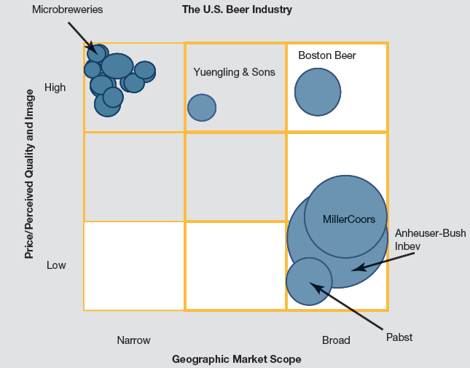
ILLUSTRATION CAPSULE 3.1
Comparative Market Positions of Producers in the U.S. Beer Industry: A Strategic Group Map Example
Footnote: Circles are drawn roughly proportional to the sizes of the firms, based on revenues.
3–44

Slide 45
ILLUSTRATION CAPSULE 3.1
Comparative Market Positions of Producers in the U.S. Beer Industry: A Strategic Group Map Example
Which strategic group is located in the least favorable market position? Which group is in the most favorable position?
Which strategic group is likely to experience increased intragroup competition?
Which groups are most threatened by the likely strategic moves of members of nearby strategic groups?
3–45

Slide 46
Some strategic groups are more favorably positioned than others because they confront weaker competitive forces and/ or because they are more favorably impacted by industry driving forces.
3–46

Slide 47
THE VALUE OF STRATEGIC GROUP MAPS?
Maps are useful in identifying which industry members are close rivals and which are distant rivals.
Not all map positions are equally attractive:
Prevailing competitive pressures from the industry’s five forces may cause the profit potential of different strategic groups to vary.
Industry driving forces may favor some strategic groups and hurt others.
3–47

Slide 48
QUESTION 5: WHAT STRATEGIC MOVES ARE RIVALS LIKELY TO MAKE NEXT?
Competitive Intelligence
Information about rivals that is useful in anticipating their next strategic moves.
Signals of the Likelihood of Strategic Moves:
Rivals under pressure to improve financial performance
Rivals seeking to increase market standing
Public statements of rivals’ intentions
Profiles developed by competitive intelligence units
3–48

Slide 49
Studying competitors’ past behavior and preferences provides a valuable assist in anticipating what moves rivals are likely to make next and outmaneuvering them in the marketplace.
3–49

Slide 50
USEFUL QUESTIONS TO HELP PREDICT THE LIKELY ACTIONS OF IMPORTANT RIVALS
Which competitors’ strategies are achieving good results?
Which competitors are losing in the marketplace or badly need to increase their unit sales and market share?
Which rivals are likely make major moves to enter new geographic markets or to increase sales and market share in a particular geographic region?
Which rivals can expand product offerings to enter new product segments where they do not have a presence?
Which rivals can be acquired? Which rivals are financially able and looking to make an acquisition?
3–50

Slide 51
A FRAMEWORK FOR COMPETITOR ANALYSIS
Indicators of a rival firm’s likely strategic moves and countermoves:
The rival firm’s current strategy
The rival firm’s objectives
The rival firm’s capabilities
The rival firm’s assumptions about itself and its industry
3–51

Slide 52
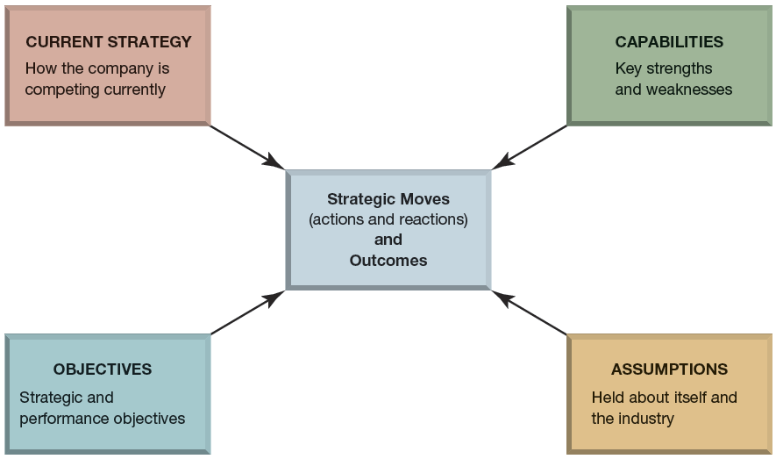
FIGURE 3.9
A Framework for Competitor Analysis
3–52

Slide 53
CREATING A STRATEGIC PROFILE OF A RIVAL COMPETITOR FIRM
Current Strategy
How is the competitor positioned in the market?
What is the basis for its competitive advantage?
What kinds of investments is it making (as an indicator of its expected growth trajectory)?
Objectives
What are its financial performance objectives?
What are its strategic objectives?
How well is it performing in meeting its objectives?
Is it under pressure to improve its performance?
3–53

Slide 54
CREATING A STRATEGIC PROFILE OF A RIVAL COMPETITOR FIRM (cont’d)
Capabilities
What are the competitor’s current capabilities?
What weaknesses does it have?
Which capabilities is it making efforts to obtain?
Assumptions
What do the competitor’s top managers believe about their strategic situation?
How will their beliefs affect the competitor’s behavior in the market?
3–54

Slide 55
QUESTION 6: WHAT ARE THE INDUSTRY’S KEY SUCCESS FACTORS?
Key Success Factors (KSFs)
Are the strategy elements, product and service attributes, operational approaches, resources, and competitive capabilities that are necessary for competitive success by any and all firms in an industry.
Vary from industry to industry, and over time within the same industry, and in importance as drivers of change and competitive conditions change.
3–55

Slide 56
Key success factors are the strategy elements, product and service attributes, operational approaches, resources, and competitive capabilities that are essential to surviving and thriving in the industry.
3–56

Slide 57
IDENTIFICATION OF KEY SUCCESS FACTORS
On what basis do buyers of the industry’s product choose between the competing brands of sellers? That is, what product attributes and service characteristics are crucial to competitive success?
Given the nature of competitive rivalry prevailing in the marketplace, what resources and competitive capabilities must a firm have to be competitively successful?
What shortcomings are almost certain to put a firm at a significant competitive disadvantage?
3–57

Slide 58
QUESTION 7: IS THE INDUSTRY OUTLOOK CONDUCIVE TO GOOD PROFITABILITY?
The anticipated industry environment is fundamentally attractive if it presents a company with good opportunity for above-average profitability.
The industry outlook is fundamentally unattractive if a firm’s profit prospects are unappealingly low.
3–58

Slide 59
FACTORS TO CONSIDER IN ASSESSING INDUSTRY ATTRACTIVENESS
The industry’s growth potential.
Whether and to what degree industry profitability will be favorably or unfavorably affected by the prevailing driving forces.
The anticipated strength of competitive forces—the overriding issue here is whether competitive forces seem likely to intensify and squeeze industry profitability to subpar levels or whether the company should be able to earn good profits despite the expected strength of competitive forces.
3–59

Slide 60
FACTORS TO CONSIDER IN ASSESSING INDUSTRY ATTRACTIVENESS (cont’d)
Whether the company is strongly or weakly positioned on the industry’s strategic group map.
How well the company’s strategy, product offering, and capabilities stack up against industry KSFs.
The degrees of risk and uncertainty in the industry’s future and whether the industry confronts severe problems relating to regulatory or environmental issues, stagnating buyer demand, industry overcapacity, and so on.
3–60

Slide 61
INDUSTRY ATTRACTIVENESS IS NOT THE SAME FOR ALL PARTICIPANTS
Future conditions in a particular industry are not equally attractive or unattractive to all industry participants and all potential entrants.
Even if a particular industry’s outlook is deemed unattractive, a favorably situated and competitively capable company may see ample opportunity to outcompete weaker rivals and significantly grow its revenues and profits.
A weak competitor in an attractive industry may conclude that fighting a steep uphill battle against much stronger rivals holds little promise of eventual market success or even average profitability.
3–61

Slide 62
INDUSTRY ATTRACTIVENESS IS NOT THE SAME FOR ALL PARTICIPANTS (cont’d)
Industry outsiders may conclude that they have the resources to easily hurdle the barriers to entering an attractive industry while other outsiders may find the same industry unattractive because they do not want to challenge market leaders and have better opportunities elsewhere.
A particular industry’s attractiveness depends in large part on whether a company has the resources and capabilities to be competitively successful and profitable in that environment.
3–62

Slide 63
WHAT SHOULD A CURRENT COMPETITOR DECIDE ABOUT ITS INDUSTRY?
When a competitor decides an industry is attractive, it should invest aggressively to capture the opportunities it sees and to improve its long-term competitive position in the business.
When a strong competitor concludes its industry is relatively unattractive and lacking in opportunity, it may elect to protect its present position, investing cautiously if at all and looking for opportunities in other industries.
A competitively weak company in an unattractive industry may see its best option as finding a buyer, perhaps a rival, to acquire its business.
3–63

Slide 64
The degree to which an industry is attractive or unattractive is not the same for all industry participants and all potential entrants.
3–64

